Slide 1
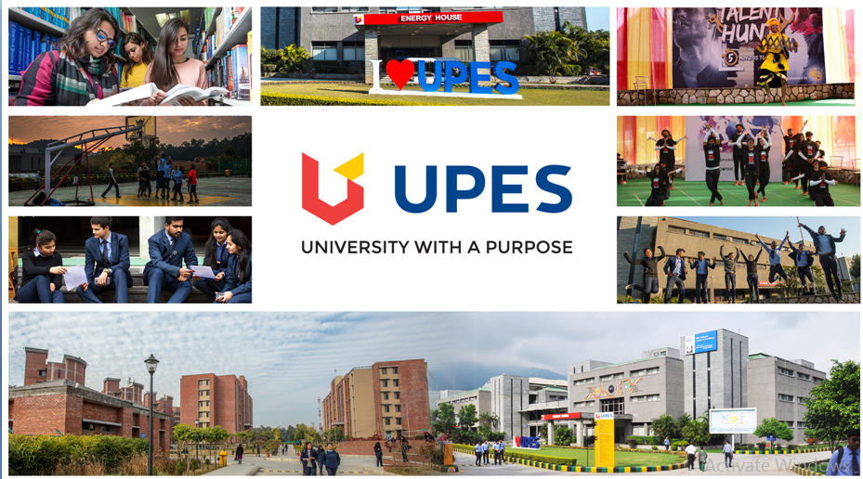

Slide 2
Minor Project - II
In
Third year – Sixth Semester of
Bachelor of Technology
specialization
In
Oil & Gas Informatics

Slide 3
Project title-: Optical Character Recognition for textual Data

Slide 4
Group Member
Name: Yash jangid
Name: Rishabh Mishra
Name: Abhinav Kamboj
Name: Arjun Gupta
SAP-ID:500071155
SAP-ID:500069163
SAP-ID:500069178
SAP-ID: 500069279
Under the supervision of
Mr. Rahul Kumar Singh
Assistant Professor
Department of Informatics

Slide 5
Content
Introduction
Objective
Methodology
Flowchart & UML diagram
Code output
Work Done
References
https://github.com/yash500071155/Optical-character-recognition-for-the-textural-data

Slide 6
Itroductio Introduction In running world there is huge demand for the software system to recognize character in computer system. As we know that these days there is a huge demand for storing the information available in these paper documents in a computer storage disk. For this problem one simple way to store information in these paper documents in to a computer system is to first scan the document then store as a image but to reuse this information it is very difficult to read the individual content and search the content.

Slide 7
Thus our need is to develop character recognition software system to perform document image analysis which transform document in paper format to electronic format among all these techniques we have optical character recognition to recognize character.

Slide 8
Objective- The primary object of optical character recognition is Recognize text and number from the input image. To speed up the recognition.

Slide 9
Methodology- In order to complete this project, we use KNN (K nearest neighbors) algorithm. By taking input as a image from MNSIT data set in a format of .gz file then, after copy the image data into a directory then by linking the directory we perform the main task of extraction. First we have to unzip all the image data then convert them into the frame of 28*28 in order to improve the accuracy. Then perform a future extraction with the help of knn algorithm .

Slide 10
And also working on to increase the accuracy because as compare to the predefined library the time complexity is high, but it shows 100 percent accuracy on the data which we have taken from the mnsit data, also it gives 85-90 percent accuracy on other format data.

Slide 11
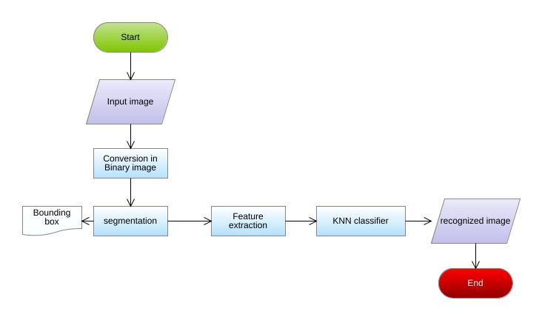
Flowchart-

Slide 12
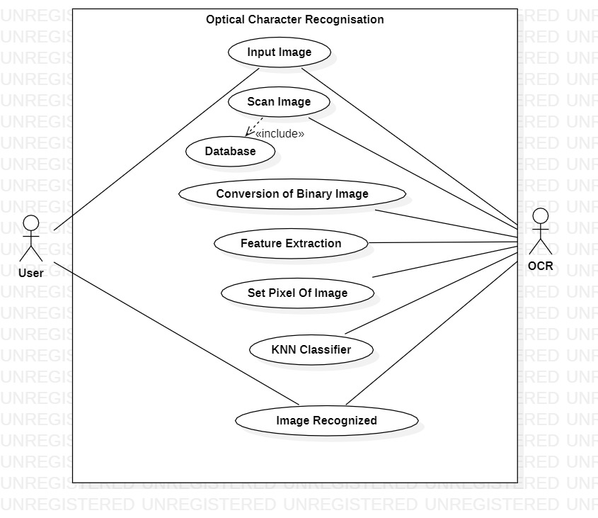
Use Case Diagram-

Slide 13
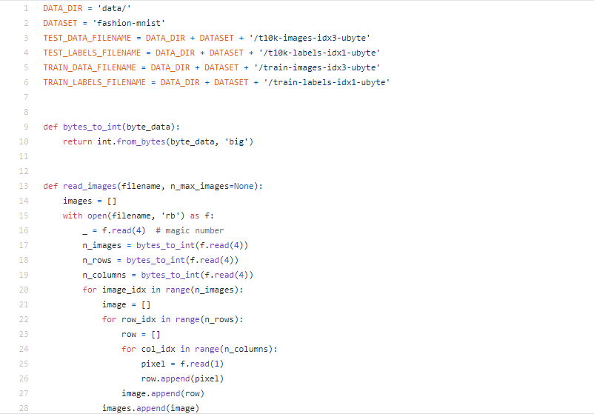
Code

Slide 14
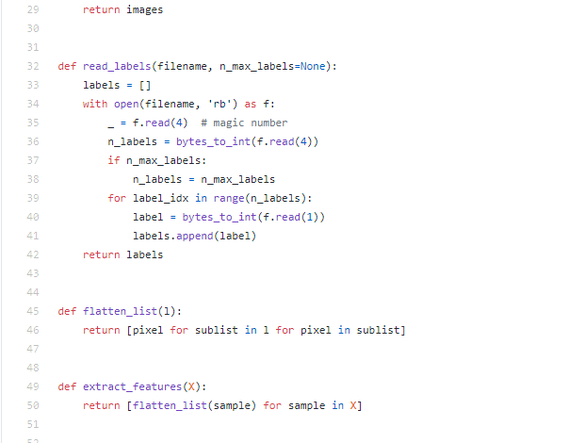

Slide 15
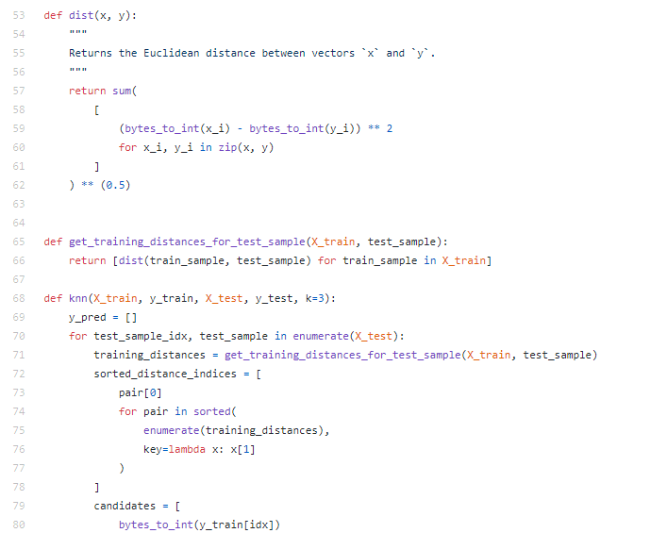

Slide 16
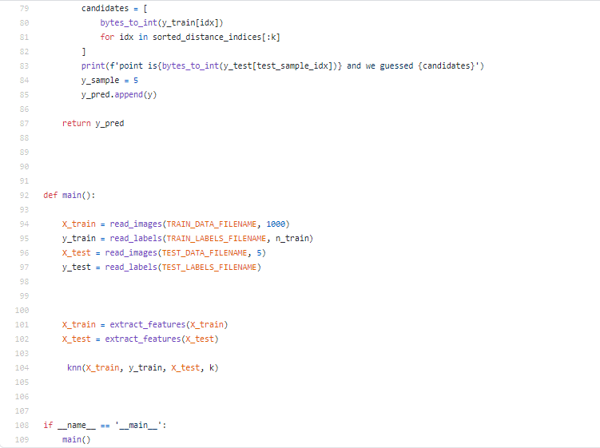

Slide 17
Work Done- Till now we have done our work in 2 phases one for number extraction and another for text , and the first phase is complete. In the last phase we are working on text set, have also compiled a code but it is not in running phase because there is some problem in featuring data. We will also be completing the last phase and running code till end sem.

Slide 18
References- http://yann.lecun.com/exdb/mnist/ https://www.sciencedirect.com/topics/computer-science/optical-character-recognition https://github.com/yash500071155/Optical-character-recognition-for-the-textural-data/blob/main/data https://nanonets.com/blog/ocr-with-tesseract/

Slide 19
Thank you

